Slide 1
DevOps – Session - 2
Gajendran V
Mail To: gajendranv@gmail.com

Slide 2
Course Topics
DevOps Version Control System
01 | Overview | 04 | GIT – What & Why | 07 | Saving Changes
02 | Benefits | 05 | Install & Configure | 08 | Repository Inspection
03 | Tools – Overview and Differences | 06 | Repository Creation | 09 | Branching & Merging
10 | Distributed Vs Centralized VCS | 11 | Working with Remote | 12 | Summary

Slide 3
Overview
Version control systems are a category of software tools that help a software team manage changes to source code over time
Version control software keeps track of every modification to the code in a special kind of database
Anytime, developers can turn back the clock and compare earlier versions of the code to help fix the mistake while minimizing disruption to all team members
VCS are some times known as:
SCM (Source Code Management)
RCS (Revision Control System)
Types of VCS
Centralized
Distributed
Types of Tools
CVS
SVN
Perforce
ClearCase
GitHub

Slide 4
Benefits
Collaboration
complete long-term change history of every file
Branching and merging
Traceability
Snapshot facility
Automatic Backups – Deleted files can be recovered
Maintaining different Versions
Sharing on Multiple Computers
Controlling the Source Code

Slide 5
Tool Differences
CVS | SVN | ClearCase | Git Hub
Shell Scripts written by Dick Grune Resolve Conflicted Code Merge Two Files | Client – Server Central Repository Local Working Copy | Initiated from DSEE (Domain Software Engineering Environment) | Peer-to-Peer Distributed Repositories Local Clones
Brian Berliner Transformed Scripts CVS was Born | Evolutionary Based on Centralized VCS Experience Driven by large community needs | Initially Released to Unix Platform Windows Support Came later | Revolutionary Based on Linux Development Model Inspired by Bitkeeper and Monotone
No Limitation | Flexible Branching - Enhanced branching capabilities | Rational – Tool Alignment | Flexible Merging Rich multi-branch merging strategies
 | Monolithic Concise Command line Reuse of CVS syntax and underlying concepts | IBM Buyout | Extensible - Unix-style commands blocks

Slide 6
Centralized Vs Distributed VCS
Centralized VCS
Centralized version control systems are based on the idea that there is a single “central” copy of your project somewhere (probably on a server), and programmers will “commit” their changes to this central copy.
“Committing” a change simply means recording the change in the central system. Other programmers can then see this change. They can also pull down the change, and the version control tool will automatically update the contents of any files that were changed.
Most modern version control systems deal with “changesets,” which simply are a groups of changes (possibly to many files) that should be treated as a cohesive whole. For example: a change to a C header file and the corresponding .c file should always be kept together.
Some of the most common centralized version control systems you may have heard of or used are CVS, Subversion (or SVN) and Perforce.
Workflow
Pull down any changes other people have made from the central server.
Make your changes, and make sure they work properly.
Commit your changes to the central server, so other programmers can see them.
Distributed VCS
These systems do not necessarily rely on a central server to store all the versions of a project’s files. Instead, every developer “clones” a copy of a repository and has the full history of the project on their own hard drive. This copy (or “clone”) has all of the metadata of the original.
The three most popular of these are Mercurial, Git and Bazaar.
More
Video Time ☺

Slide 7
GIT Hub
The most widely used modern version control system in the world today is Git
GIT is a mature, actively maintained open source Project
Originally developed in 2005 by Linus Torvalds (The famous creator of Linux Operating System Kernel)
In addition to being distributed, Git has been designed with performance, security and flexibility in mind
Security - has been designed with the integrity of managed source code as a top priority

Slide 8
Why for Organizations?
Git for Developers
Feature Branch Workflow
Branches are cheap and easy to merge
Feature Branch
Distributed Development
Pull Requests
A pull request is a way to ask another developer to merge one of your branches into their repository. This not only makes it easier for project leads to keep track of changes, but also lets developers initiate discussions around their work before integrating it with the rest of the codebase
Faster Release Cycle
Product Management
Customer Support
Designers
Human Resources
Finance (Budget)

Slide 9
Installation & Configuration
Installation Steps
Linux
sudo apt-get update
sudo apt-get install git
Windows
Download from https://git-for-windows.github.io/
Fedora
sudo yum install git
Configure Users
git config --global user.name “demo"
git config --global user.email gajendranv@gmail.com
Verification
git --version

Slide 10
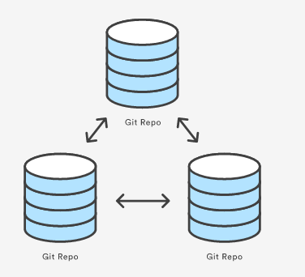
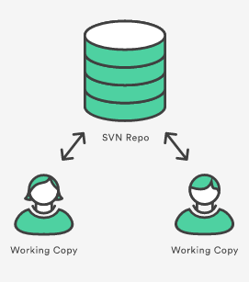
Repository Setup
git init --bare training
git clone training
git clone ssh://XXXXX
git config --system core.editor <editor>
git add <file>
git add <directory> - Staging Area (The staging area is one of Git's more unique features)
git commit –m <comments>
git status
git log
git log –n <limit>
git log --grep="<pattern>“
git log <file>
git checkout
Files
Branches
git revert <commit>
git clean (Removes untracked files)

Slide 11
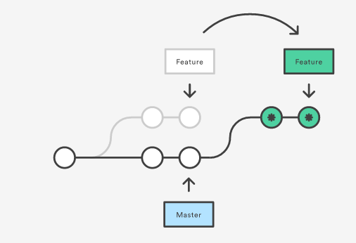
Git Rebase
Rebasing is the process of moving a branch to a new base commit.
Rebasing really is just moving a branch from one commit to another. But internally, Git accomplishes this by creating new commits and applying them to the specified base—it’s literally rewriting your project history. It’s very important to understand that, even though the branch looks the same, it’s composed of entirely new commits.
git rebase <base> (-i → Interactive)

Slide 12
Git – Quick Guide
Git task | Notes | Git commands
Tell Git who you are | Configure the author name and email address to be used with your commits.Note that Git strips some characters (for example trailing periods) from user.name. | git config —global user.name “Sam Smith”git config —global user.email sam@example.com
Create a new local repository |  | git init
Check out a repository | Create a working copy of a local repository: | git clone /path/to/repository
 | For a remote server, use: | git clone username@host:/path/to/repository
Add files | Add one or more files to staging (index): | git add <filename>git add *
Commit | Commit changes to head (but not yet to the remote repository): | git commit -m “Commit message”
 | Commit any files you‘ve added with git add, and also commit any files you’ve changed since then: | git commit -a
Push | Send changes to the master branch of your remote repository: | git push origin master
Status | List the files you've changed and those you still need to add or commit: | git status
Connect to a remote repository | If you haven't connected your local repository to a remote server, add the server to be able to push to it: | git remote add origin <server>
 | List all currently configured remote repositories: | git remote -v
Branches | Create a new branch and switch to it: | git checkout -b <branchname>
 | Switch from one branch to another: | git checkout <branchname>
 | List all the branches in your repo, and also tell you what branch you're currently in: | git branch
 | Delete the feature branch: | git branch -d <branchname>
 | Push the branch to your remote repository, so others can use it: | git push origin <branchname>
 | Push all branches to your remote repository: | git push —all origin
 | Delete a branch on your remote repository: | git push origin :<branchname>
Update from the remote repository | Fetch and merge changes on the remote server to your working directory: | git pull
 | To merge a different branch into your active branch: | git merge <branchname>
 | View all the merge conflicts:View the conflicts against the base file:Preview changes, before merging: | git diffgit diff —base <filename>git diff <sourcebranch><targetbranch>
 | After you have manually resolved any conflicts, you mark the changed file: | git add <filename>
Tags | You can use tagging to mark a significant changeset, such as a release: | git tag 1.0.0 <commitID>
 | CommitId is the leading characters of the changeset ID, up to 10, but must be unique. Get the ID using: | git log
 | Push all tags to remote repository: | git push —tags origin
Undo local changes | If you mess up, you can replace the changes in your working tree with the last content in head:Changes already added to the index, as well as new files, will be kept. | git checkout — <filename>
 | Instead, to drop all your local changes and commits, fetch the latest history from the server and point your local master branch at it, do this: | git fetch origingit reset —hard origin/master
Search | Search the working directory for foo(): | git grep “foo()”

Slide 13
SVN – GIT Migration
There’s a number of tools available to help you migrate your existing projects from SVN to Git, but before you decide what tools to use, you need to figure out how you want to migrate your code. Your options are:
Migrate your entire codebase to Git and stop using SVN altogether.
Don’t migrate any existing projects to Git, but use Git for all new projects.
Migrate some of your projects to Git while continuing to use SVN for other projects.
Use SVN and Git simultaneously on the same projects.
Atlassian’s migration scripts are a good choice for you. These scripts provide all the tools you need to reliably convert your existing SVN repositories to Git repositories. The resulting native-Git history ensures you won’t need to deal with any SVN-to-Git interoperability issues after the conversion process.
Steps Involved
Prepare
Convert
Synchronize
Share
Migrate

Slide 14
Migration Steps
Prepare
Download Migration Scripts
https://bitbucket.org/atlassian/svn-migration-scripts/downloads?_ga=1.20321213.401884483.1472017145 (svn-migration-scripts.jar)
java -jar ~/svn-migration-scripts.jar verify
Verify the Pre-requisites (JRE, GIT, SVN, git-svn)
Convert
git svn clone --stdlayout --authors-file=authors.txt <svn-repo>/<project> <git-repo-name>
Synchronize
java -Dfile.encoding=utf-8 -jar ~/svn-migration-scripts.jar sync-rebase

Slide 15
Course Topics
DevOps Web & App Server
01 | Overview
02 | Apache Web Server
03 | Application Server
10 |

Slide 16
Apache
Video Time
Download URL
http://redrockdigimark.com/apachemirror//httpd/binaries/

